Slide 1

Dual-Active-Bridge (DAB) Converter and its Usage in Electric Vehicles (EVs)
-Advancing Efficiency and Power Management in EV Systems
1. Medipally Saivivek
2.Chandana Basva
3. Saswat Satapathy
4. Bhaskar Poornesh
5. Mokshyada Mishra

Slide 2
Introduction
What is a DAB Converter?
A Dual-Active-Bridge (DAB) converter is a type of bidirectional DC-DC converter.
Provides power transfer between two DC voltage sources.
Features:
Galvanic isolation: Prevents unwanted currents between circuits.
Bidirectional power flow: Enables energy recovery, crucial for regenerative braking.
Soft-switching: Reduces energy losses and heat generation.
Why is it Relevant to EVs?
EVs require efficient power conversion systems for:
Managing energy between high-voltage batteries and low-voltage auxiliary systems.
Enabling regenerative braking and energy recovery.
DAB converters offer compact, lightweight, and highly efficient solutions for EV power systems.

Slide 3
Key Features of DAB Converters
High-Frequency Transformers
1
Allows compact designs and reduced weight.
Essential for space-constrained EV systems.
2
Bidirectional Power Flow
Supports energy flow in both directions:
Battery to motor for driving.
High Power Density
3
Motor to battery during regenerative braking.
Compact design reduces the overall weight of EV power systems.
4
Integration of Wide-Bandgap Devices
SiC and GaN semiconductors:
Enable higher switching frequencies.
Improve thermal performance, reducing heat dissipation requirements.

Slide 4
Applications in EVs
Battery Energy Storage Systems (BESS)
1
Manages charging and discharging of EV batteries.
Balances energy flow between the battery and drivetrain.
2
Regenerative Braking
Recovers kinetic energy during braking and stores it back in the battery.
Traction Systems
3
Provides power to the motor efficiently, even under varying speed and load conditions.
4
Fast-Charging Infrastructure
Reduces energy loss during high-power charging cycles.
Supports modular and scalable EV charging systems.

Slide 5
Why DAB Converter?
-When the rated voltage and current of switches are the same, the transmission power of IBDC is proportional to the number of switches, such as the power capacity of four-switch IBDC is double that of dual-switch IBDC but half that of eight-switch IBDC, so the DAB-IBDC has the biggest power capacity.
-The output pulsation frequency for forward converter is switching frequency but for the push–pull, half-bridge and full-bridge converters is double switching frequency, so with the same output voltage, the filter for DAB-IBDC is also small.
-DAB-IBDCs have the advantages of ease of realizing soft-switching, bidirectional power transfer capability, and modular and symmetric structure.
-In recent years, the advances in new power devices and magnetic materials (especially the development of silicon carbide (SiC)- and gallium-nitride (GaN)-based power devices and iron-based nanocrystalline soft magnetic) have made DAB-IBDC feasible for eliminating bulky and heavy LF transformers from PCSs

Slide 6
SiC
DAB converters are operated at high switching frequencies leading to higher switching loss. This issue can be addressed by employing SiC and GaN-MOSFETs, which work with lesser switching losses and can operate at much higher switching frequency
DAB enabled with SiC MOSFET can be designed for lower phase shifts compared to Si-IGBT enabled DAB, which inherently reduces the inductor size and circulating current in a DAB.
SiC-MOSFET devices have a higher transient current carrying capability than Si-IGBT devices due to their superior thermal conductivity.
SiC and GaN based power semiconductor switches, are widely adopted due to their ability to operate at a higher switching frequency, higher voltage ratings, higher temperatures, and lesser switching losses due to lower on-state resistance compared to Si power semiconductor switches.

Slide 7
CONTROL STRATEGY
1. SPS CONTROL STRATEGY:-
In SPS control, the cross-connected switch pairs in both full bridges are switched in turn to generate phase- shifted square waves with 50% duty ratio to the transformer’s primary and secondary sides. Only a phase-shift ratio (or angle) D can be controlled.
2. EPS CONTROL STRATEGY:-
In EPS control, the cross-connected switch pairs in one full bridge are switched in turn, while switch pairs in another bridge are switched with an inner phase-shift ratio. In this the circulating power decreases for a given transmission power. EPS control not only improves efficiency and expands the ZVS operation range, but also reduces the current stress and enhances the regulating flexibility.
3. TPS CONTROL STRATEGY:-
The cross-connected switch pairs in both full bridges are switched with an inner phase-shift ratio. However, the inner phase-shift ratios may be unequal. TPS control can also control three degrees of freedom. For EPS control, the operating states of the two bridges should be changed when the voltage conversion states or power flow directions are changed.
4. DPS CONTROL STRATEGY:-
Different with the EPS control, in DPS control, the cross-connected switch pairs in both full bridges are switched with an inner phase-shift ratio, and the inner phase-shift ratios are the same. Then, the output ac voltages of both bridges are three-level waves. DPS control is easier to implement, and its dynamic performance may be more excellent.

Slide 8
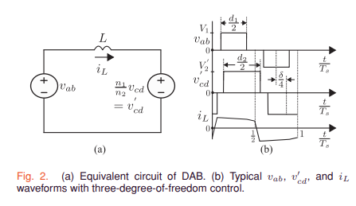
Analysis and Optimal Design
The DAB converter’s design requires determining the transformer turns ratio (“n”) and series inductance (“L”).
Soft switching is ensured through a triple-phase-shift (TPS) modulation strategy, minimizing the RMS current.
The pulsewidths are decided by d1Ts/2 and d2Ts/2 for primary and secondary voltages, respectively, as shown in Fig. 2(b). The time shift δTs/4 is provided for power transfer, where Ts = 1/fs. It can be seen from Fig. 2(b) that the duty cycles d1, d2 ∈ [0, 1]. The phase shift ranges between −Ts 4 and Ts 4 , which corresponds to δ ∈ [−1, 1].
The optimal modulation parameters are determined analytically to minimize losses and ensure soft switching.
The design aims for the RMS current to stay near its optimal value despite voltage variations at the unregulated port.

Slide 9
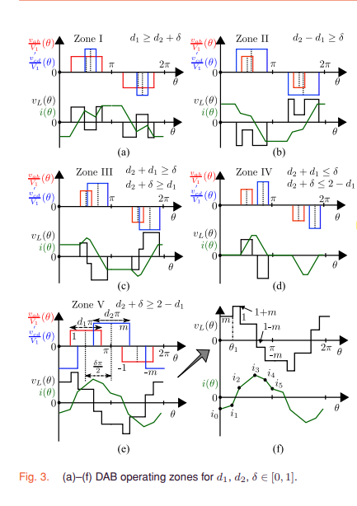
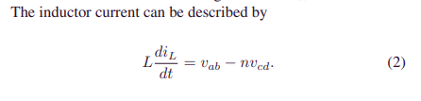
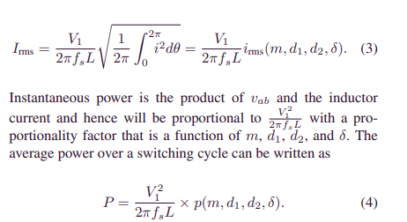
Problem Statement
Design a DAB converter to minimize the worst-case inductor RMS current over a defined operating range while ensuring soft switching across all operating points.
Constraints: Ensure soft-switching conditions for all operating zones.
Consider a DAB converter with the following specifications:
Port 1 Voltage: V1, switching frequency: fs
Port 2 Voltage: V2min ≤ V2 ≤ V2max Power Rating: Pmin ≤ P ≤ Pmax.

Slide 10
Conditions for Soft Switching
Current polarity constraints for ZVS:Switch current must be zero at the instant of voltage transition.
Ensure all transitions between switches and diodes satisfy ZVS conditions.
Evaluate conditions independently for all zones of operation.
Key operating zones: Zones I, II, and V.
Simultaneous satisfaction of constraints ensures optimal efficiency and minimal switching losses.

Slide 11
Optimal Modulation Strategy
Triple-phase-shift (TPS) modulation minimizes the inductor RMS current while ensuring soft switching.
Modulation parameters are optimized for a given operating point.
Objective: Minimize .
Constraints: Ensure ZVS conditions across all operating zones.
Solution involves analytical determination of parameters for three distinct regions of operation, balancing RMS current and switching losses.

Slide 12
Efficiency and Loss Breakup
Efficiency peaks at 97% for and .
Loss components:
Primary and secondary conduction losses
Transformer and inductor copper losses
Core losses
Analytical and experimental validations confirm close alignment with theoretical predictions.

Slide 13
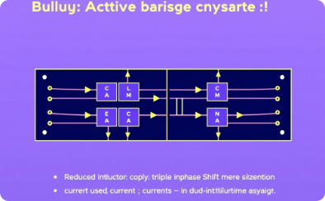
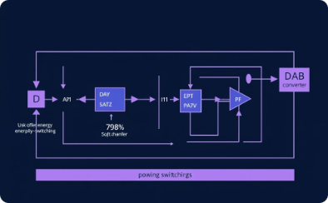
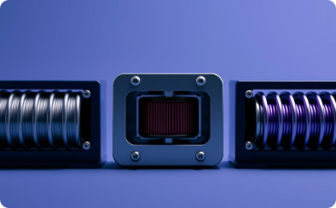
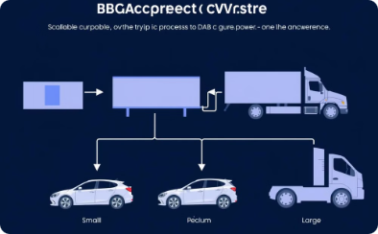
Design Considerations for EV Integration
Triple-Phase-Shift (TPS) Modulation Strategy
Soft-Switching Techniques
Component Optimization
Scalability
Adaptable for different EV power requirements, from small passenger cars to heavy-duty vehicles.
Ensures minimal energy dissipation during power transfer, extending component lifespan and reducing maintenance.
Lightweight transformers and compact inductors designed specifically for EV power systems.
Reduces inductor RMS currents, minimizing energy losses and heat generation.

Slide 14
Efficiency and Performance
Experimental Results:
Achieved 97% peak efficiency in a 2.6 kW prototype.
Reduction in conduction and core losses validated through testing.
Performance Metrics for EVs:
Handles dynamic loads effectively, including acceleration and regenerative braking.
Maintains high efficiency under variable voltage and power demands.
Comparison with Conventional Designs:
DAB converters show superior performance in energy efficiency and size reduction.

Slide 15
Advantages of DAB Converters in EVs
Lightweight and Compact Systems:
Ideal for modern EV designs where space and weight are constrained.
Energy Efficiency:
Reduces power losses during high-speed operation or charging.
Scalability:
Modular designs cater to various EV types and configurations.
Reliability and Longer Life:
Lower heat generation and reduced stress on components lead to longer system life.

Slide 16
Future Prospects
1. Integration with SiC/GaN Devices:
Improves switching speeds and reduces energy losses.
Essential for next-generation EVs and charging systems.
2. Modular Designs:
Scalable solutions for various applications: personal EVs, buses, and trucks.
3. Advanced Control Strategies:
Enhanced TPS modulation techniques to further optimize power transfer.
4. Wider Adoption in Charging Infrastructure:
Key to achieving fast, efficient, and widespread EV adoption.

Slide 17
Conclusion
Summary:
DAB converters play a vital role in EV energy management.
Key benefits include high efficiency, compact designs, and bidirectional power flow.
Looking Ahead:
With advancements in materials and modulation strategies, DAB converters will continue to be integral to EVs and their supporting infrastructure.

